Slide 1
The Rady School of Management
MGT 167 • Fall 2023
Social Entrepreneurship: Doing Well by Doing Good
Wednesday, October 25

Slide 2

Class administration
Mandatory 1:1 Office Hours due Sun. 29 Oct
32 pending
Today after class 12:30 - 1pm
Zoom waiting room option (sign up)
Thursday 26 Oct and Friday 27 Oct
4:30 pm – 5:30 pm
Let me know your availability Sat. 28 and Sun. 29 Oct

Slide 3

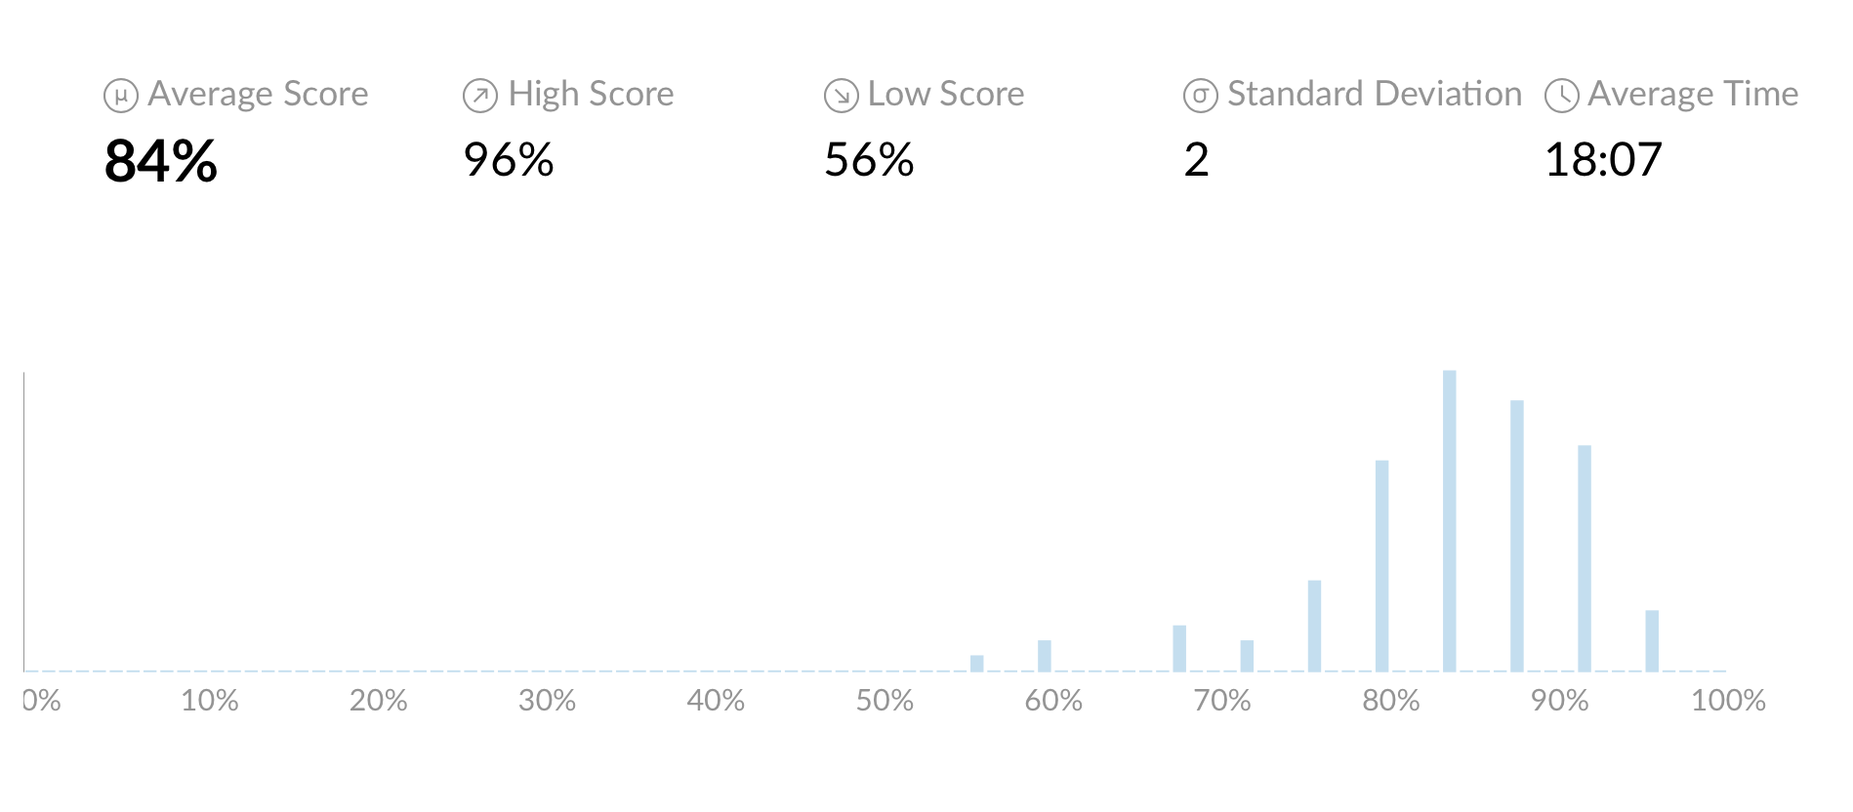
Quiz #1 Results
Top scores:
Ramon, Athena, Tyler K., Berk

Slide 4

Feedback from Monday, 23 Oct.
++++“Can barely see to write this with lights off.”
“Loved how the passion pitch started off in the dark. How creative!”
“It was super fun being a part of the Passion team experience.”
“Passion pitches were simply awesome!”
“Enjoyed seeing my classmates share their passions.”
“What talent and creativity! Entertaining!”
“Now I know what to do in my own group.”
“Great feedback for passion pitches.”

Slide 5
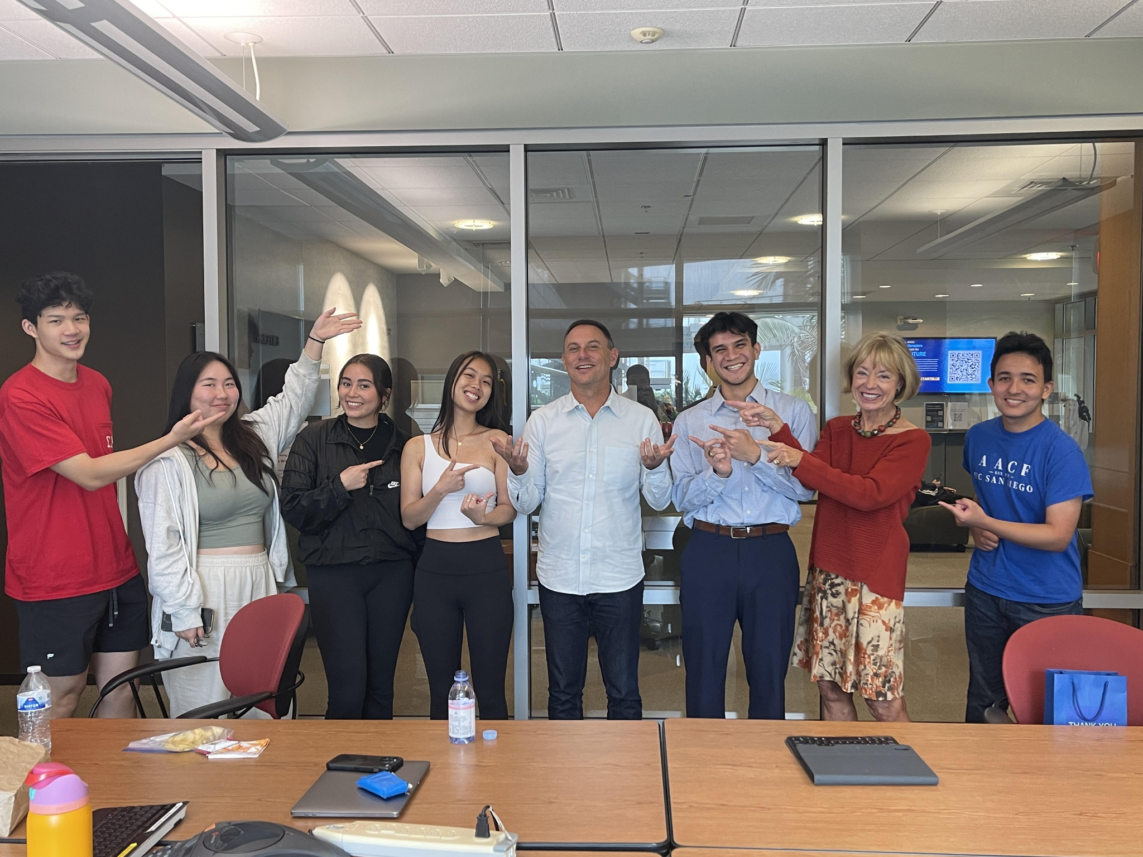
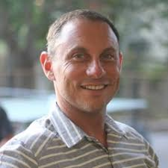
Feedback from Monday, 23 Oct.
“Guest speaker was not as engaging
as the others.”
Brown bag experience?
CP points
Katie, Jeffrey, Irene, Yaman(?), Vanessa, Hannah
Used Q-A protocols ++
Berk, Phillip

Slide 6
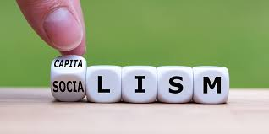
ESG
Environmental
Social
Governance (corporate)
Investing strategies should consider ESG issues.
Used since UN-sponsored report, “Who Cares Wins” (2004). Contrasts with Milton Friedman’s doctrine “The Social Responsibility of Business is to increase its profits.” (1970)
Stakeholder v. Shareholder Capitalism

Slide 7

Networking
Hierarchy of communication
Pillow talk
Eyeball to eyeball
Skype, FaceTime, WeChat
Telephone conversation
Voice mail
Facebook, WhatsApp, Instagram, LinkedIn, other visual
Text, e-mail, twitter, other social media

Slide 8
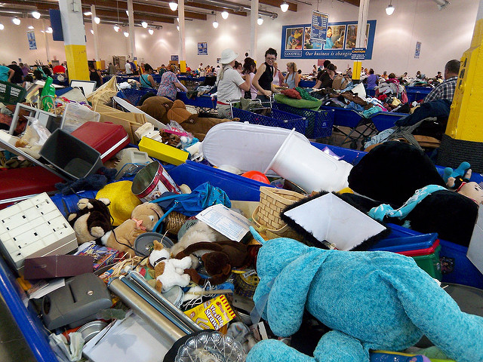

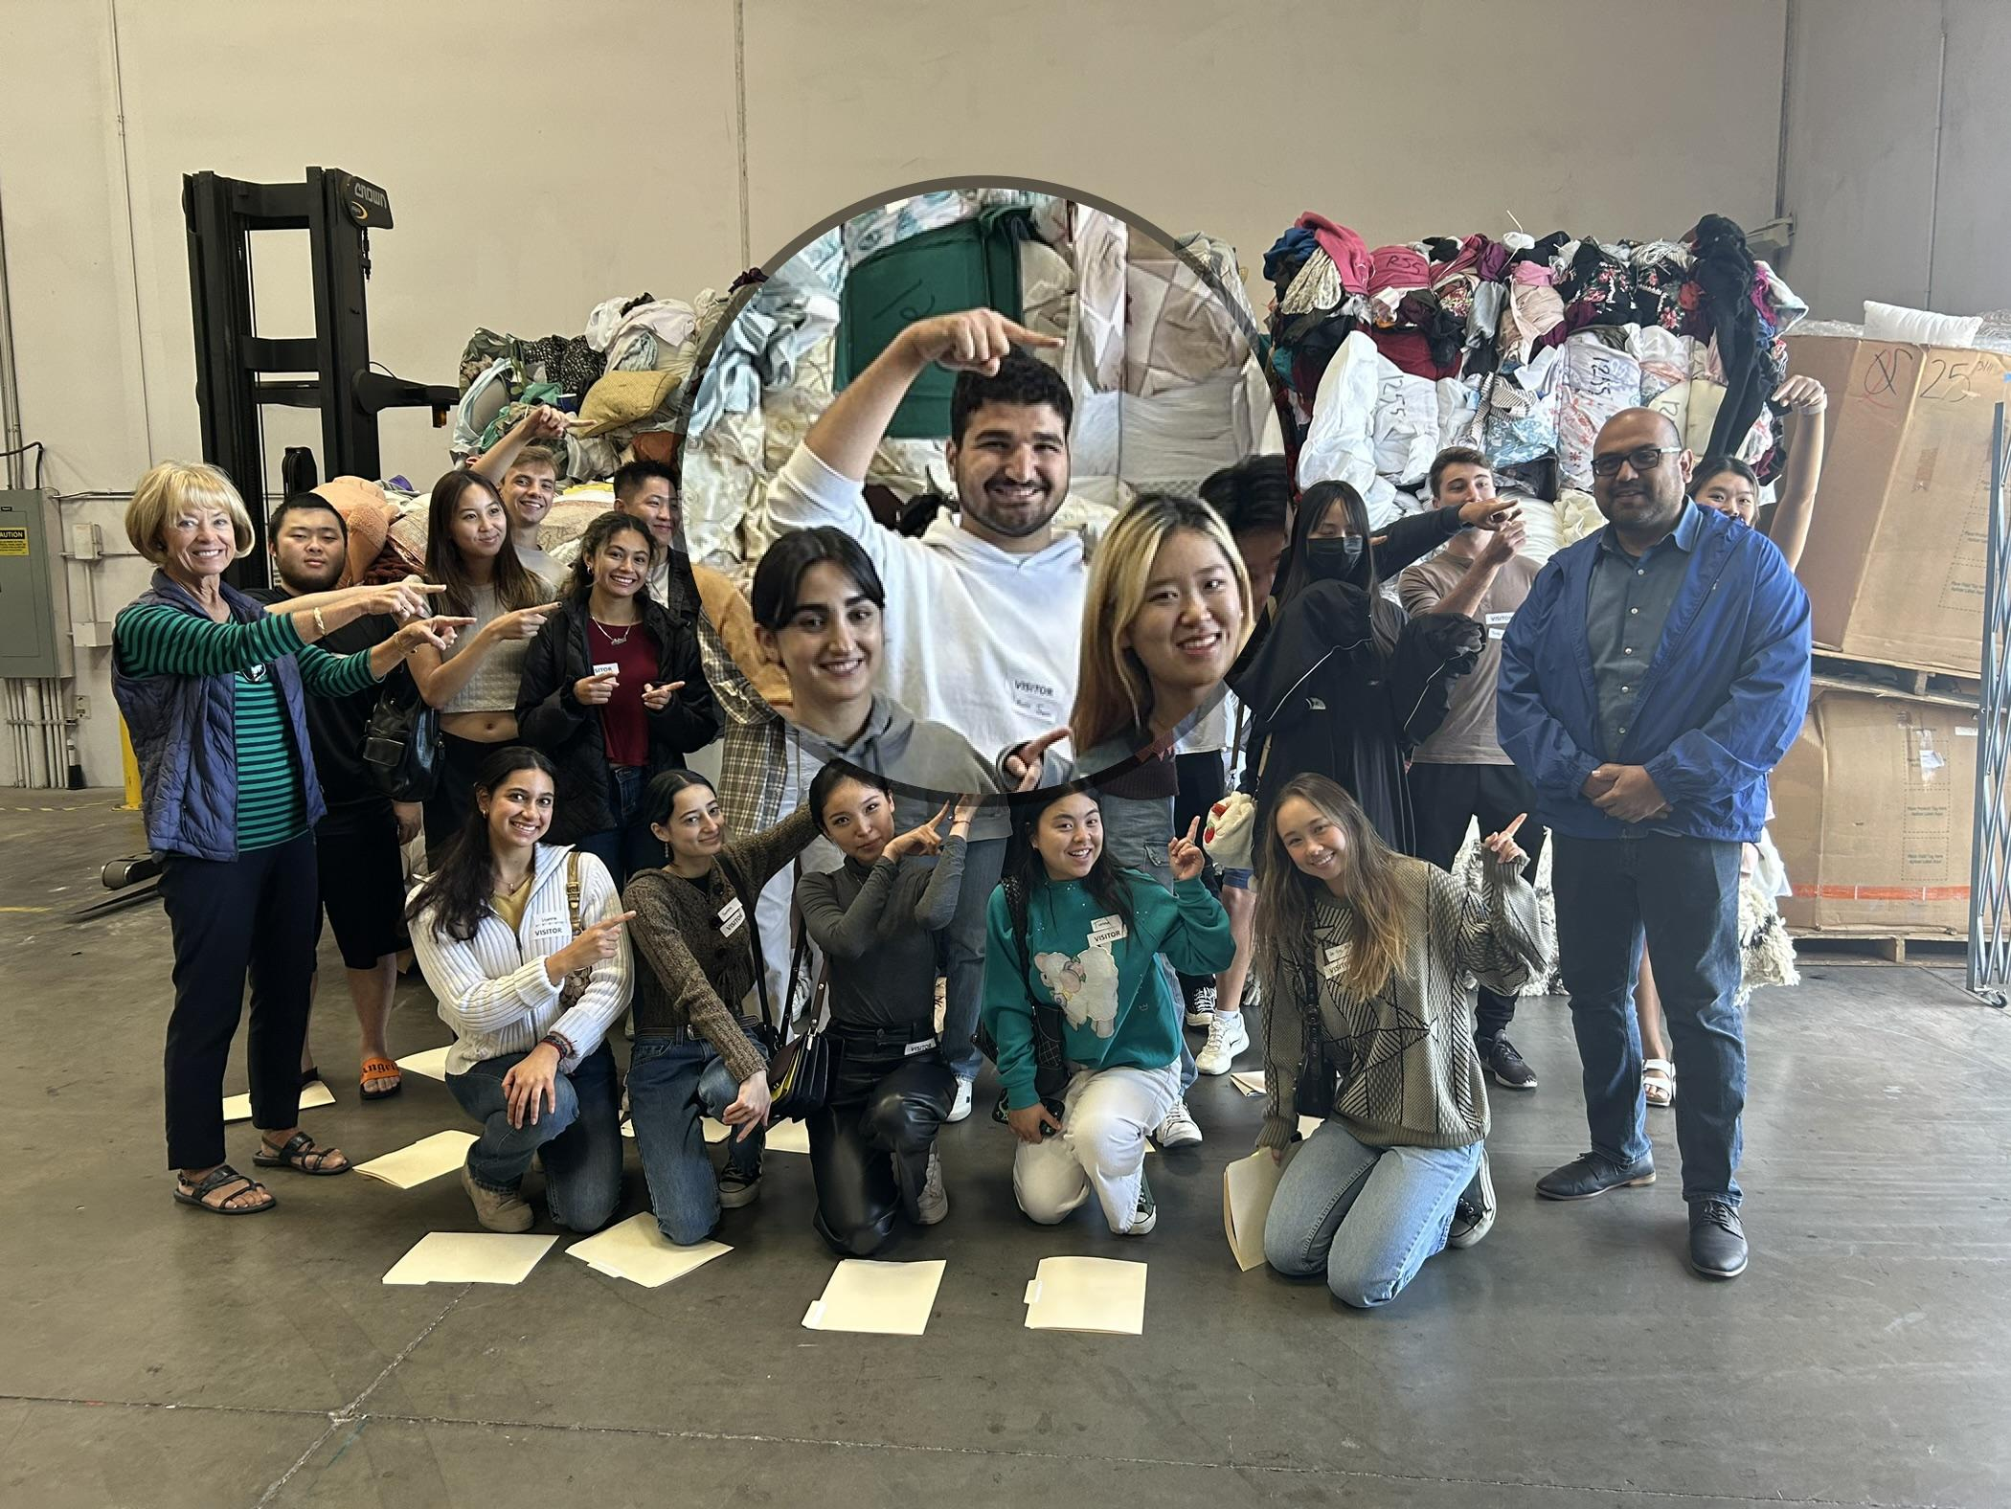
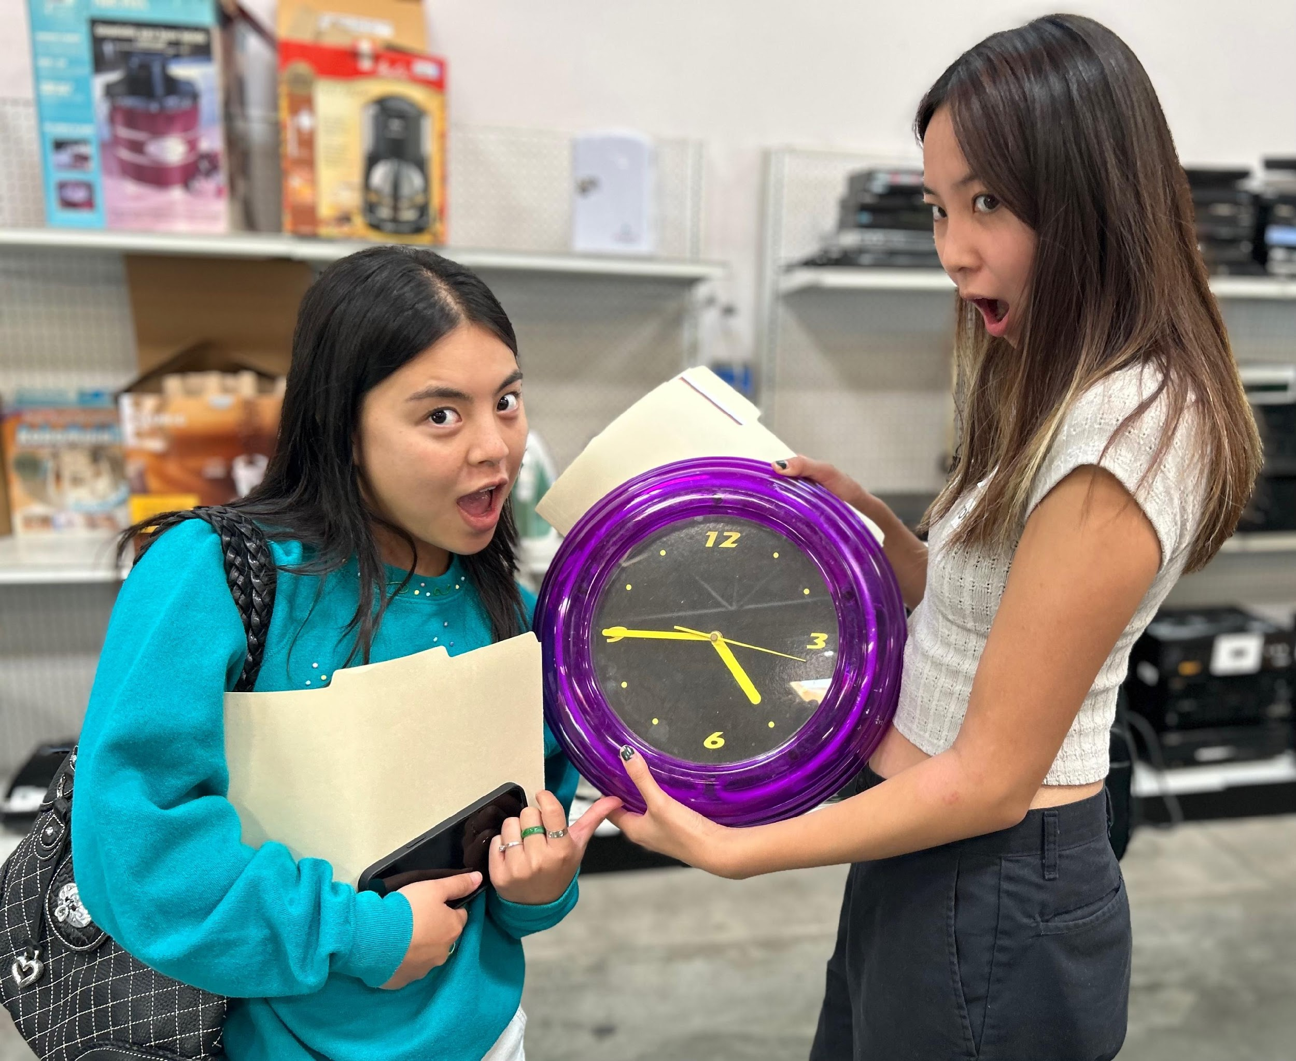
Optional Field Trip Friday, 3 November 10 am
2383 Via Segundo
San Ysidro, CA
92173

Slide 9
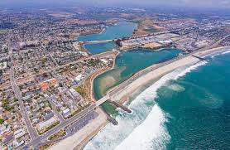
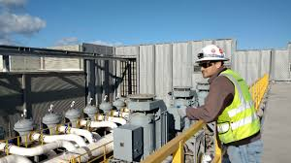
Optional Field Trip Friday, 10 November 10 am
Carlsbad
Desalinization Plant

Slide 10

Passion Pitch
Food Waste

Slide 11

The Rady School of Management
Fund Raising
Part 1

Slide 12
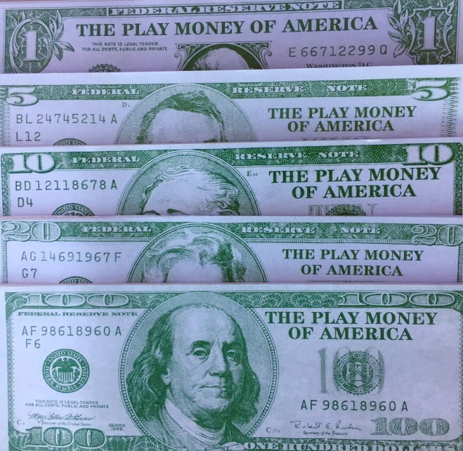
Social Entrepreneurship
You have…
Passion for doing well by doing good
Fundamentals of non-profits
Now what?
You need to raise money!

Slide 13
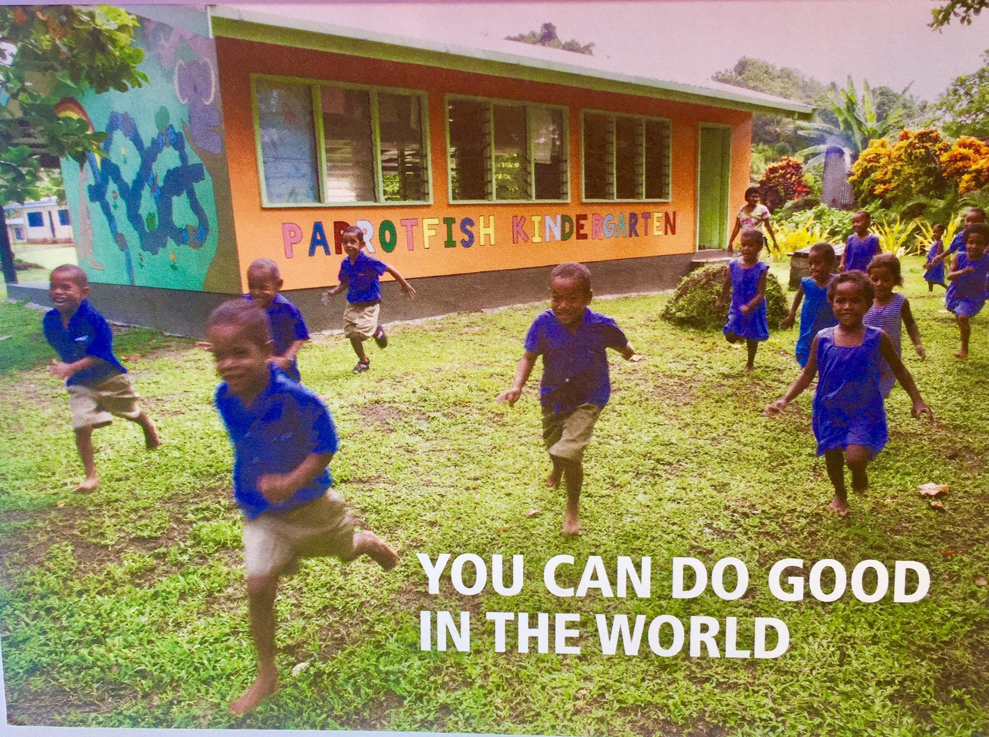
Charity is
Big Business!
Donations $410 B 5.4% GDP interchangeable with NFP
$

Slide 14
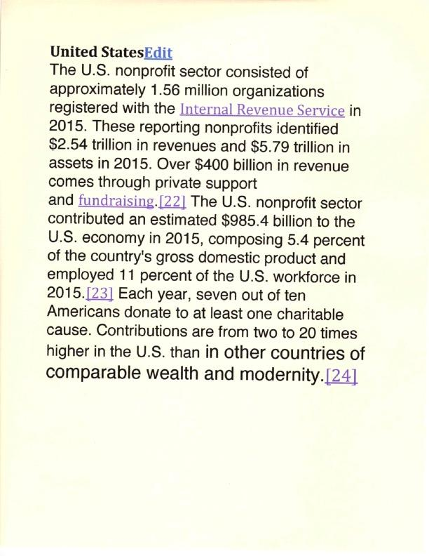

Slide 15
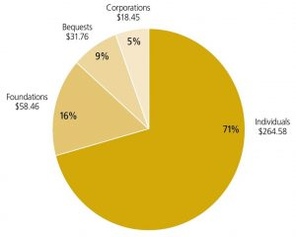
Fundraising: The Giving Pie

Slide 16
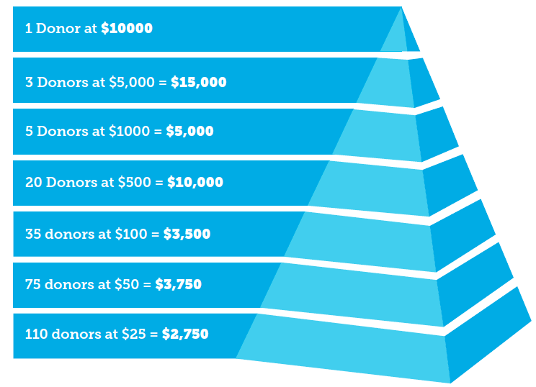
Fundraising: $50,000 Campaign Pyramid

Slide 17
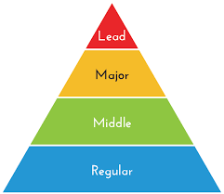
Fundraising: The Campaign Pyramid
Prospects must be qualified and interested
Four appointments for every successful “ask”
Big “asks”= no more difficult than small “asks”
Work from top to bottom of pyramid
Beware of asking too little
Matching gifts = Successful strategy
Finish the campaign…homestretch donors

Slide 18
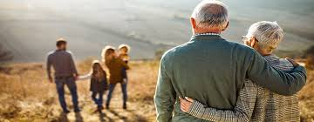
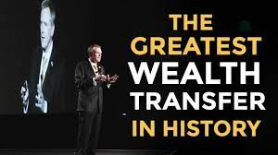
The Great Wealth Transfer

Slide 19

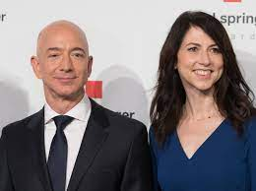

MacKenzie Scott’s $84 million gift October 18, 2022
Girl Scouts USA

Slide 20
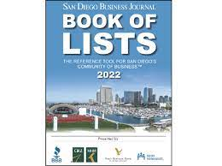
San Diego Business Journal Book of Lists
Table of contents
Wealthiest
Non-Profits (grants)
Family Foundations
Corporations

Slide 21
Fundraising: The Giving Pie

Slide 22


Next Class Monday, Oct 30 (4) Stanford Social Innovation Review (SSIR) articles Review: Dan Pallotta TED Talk Acumen Academy: Ultimate Intro Guide
Passion Pitches

Slide 23
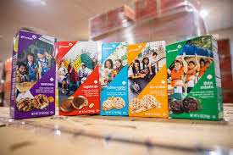
Drawing for Girl Scout Cookies

